Slide 1

Rhizosphere microbiome structure alters to enable wilt resistance in tomato
根际微生物组结构改变使番茄具有抗青枯病性
Zhang jingying
2018.11.23

Slide 2

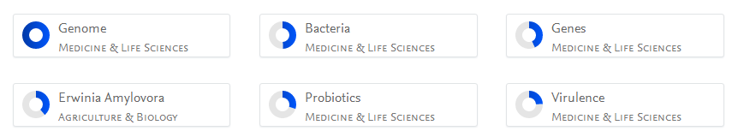

About The Author
Author 1
Jihyun F. Kim
Yonsei University, Department of Systems Biology, Division of Life Sciences,
Seoul, South Korea
https://yonsei.pure.elsevier.com/en/persons/jihyun-f-kim/clippings/
Author 2
Seon-Woo Lee
Dong-A University, Department of Applied Biology,
Busan, Republic of Korea.
Some fungal endophytes from vegetable crops and their anti-oomycete activities against tomato late blight
H.-Y. Kim, G.J. Choi, H.B. Lee, S.-W. Lee, H.K. Lim, K.S. Jang, S.W. Son, S.O. Lee, K.Y. Cho, N.D. Sung, J.-C. Kim
Supported by
Strategic Initiative for Microbiomes in Agriculture and Food (914001-4 to J.F.K. and 914006-4 to J.Y.S.)

Slide 3
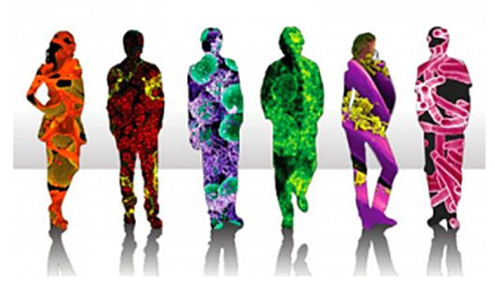
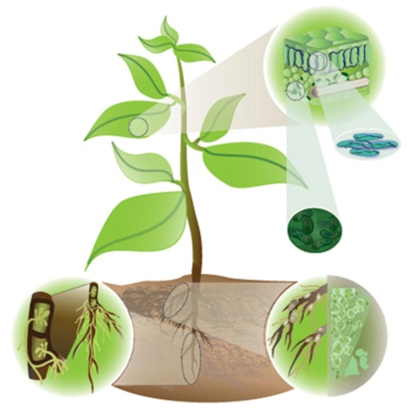
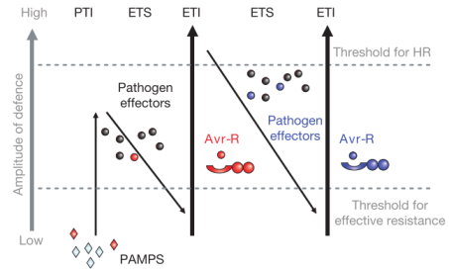
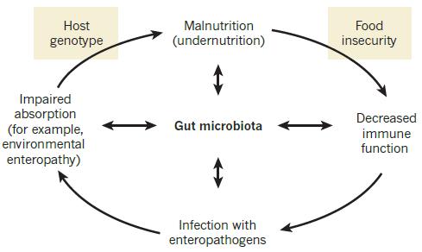
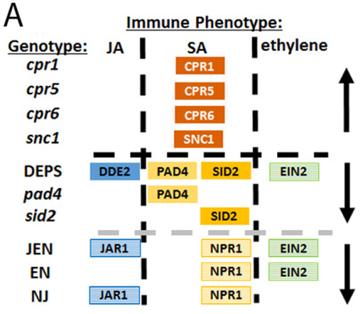
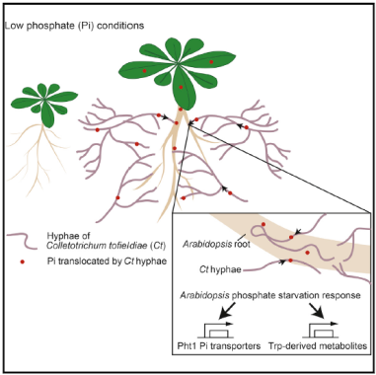
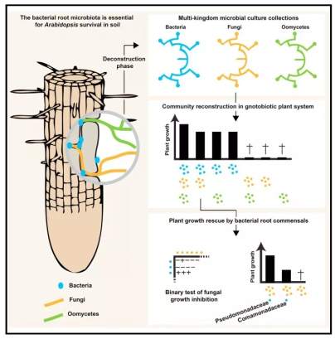
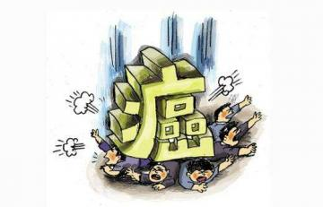

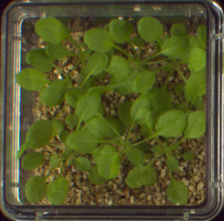
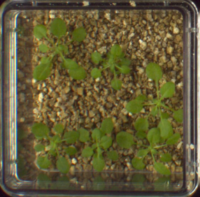
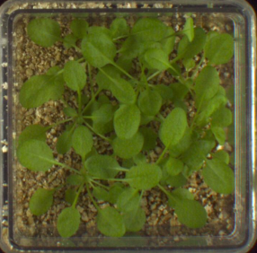
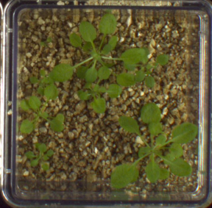
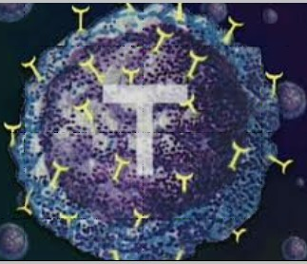
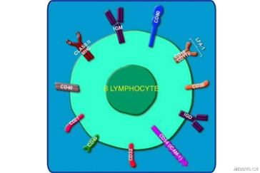
Research Background
Dangl and Jones, 2001
帕金森
Lebeis et al., 2015; Hiruma et al., 2016; Durán et al., 2018
Mock
F. oxysporum
F. Oxysporum
+root microbiota
F. oxysporum
+heated root microbiota
Cheema et al., 2016; Scheperjanset al., 2015; Atarashi et al., 2013; Duane et al., 2013
Bai unpublished

Slide 4
Scientific Question
Find the insufficient:
In Arabidopsis thaliana, salicylic acid shapes the root microbiome, but a mechanistic role for plant microbiota in pathogen defense has not yet been established.
Introduce the question:
The structure and function of the plant microbiome in disease development?
Whether plant-associated microorganisms have a role in disease resistance?

Slide 5
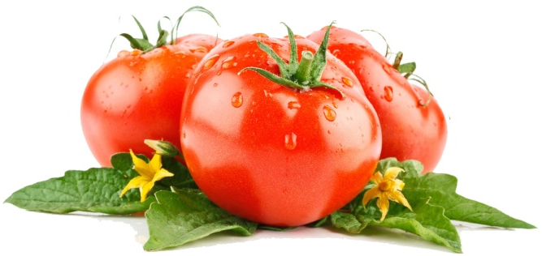
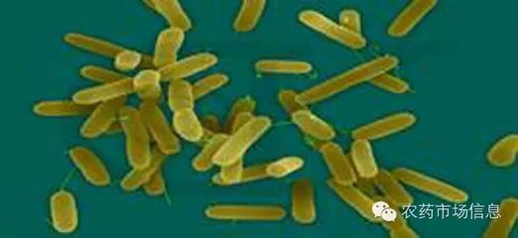
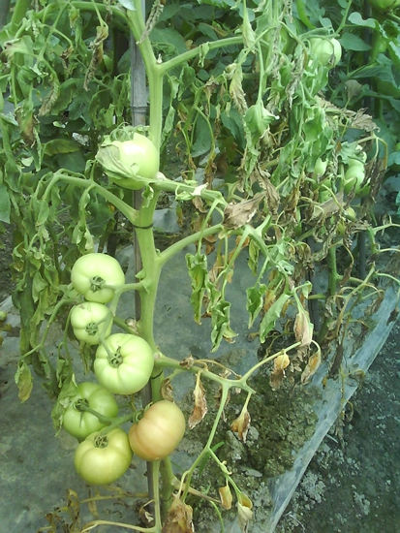
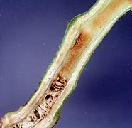
Research Design
Tomato（番茄）
Resistant variety: Hawaii 7996
Susceptible variety : Moneymaker
Structure of the tomato rhizosphere microbiome
A model plant /Disease resistance
Tomato Genome Consortium, 2012
Microbiota and disease development
Bacterial wilt（细菌性青枯病）
Metagenomic assembly of a flavobacterial genome
Using reference genomes to infer flavobacterial functions
Cultivation of TRM1
Ralstonia solanacearum （青枯菌）
soil-borne disease （土传病害）
Extracellular Polysaccharide, EPS （胞外多糖）
TRM1 and disease resistance
Vasse, 1995; Denny 1995; Kao et al., 2012

Slide 6
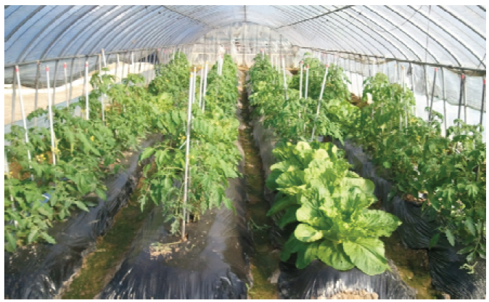
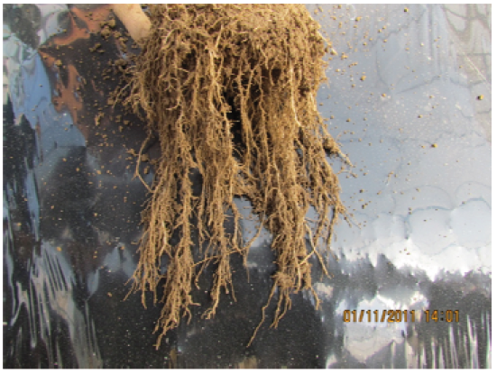
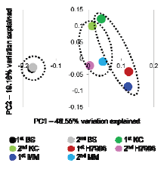
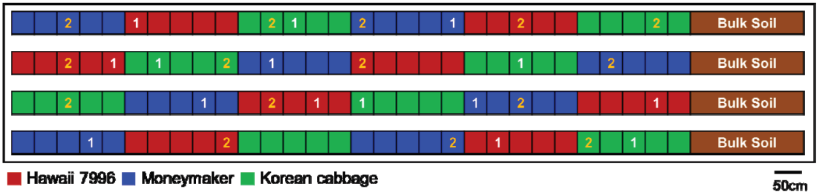
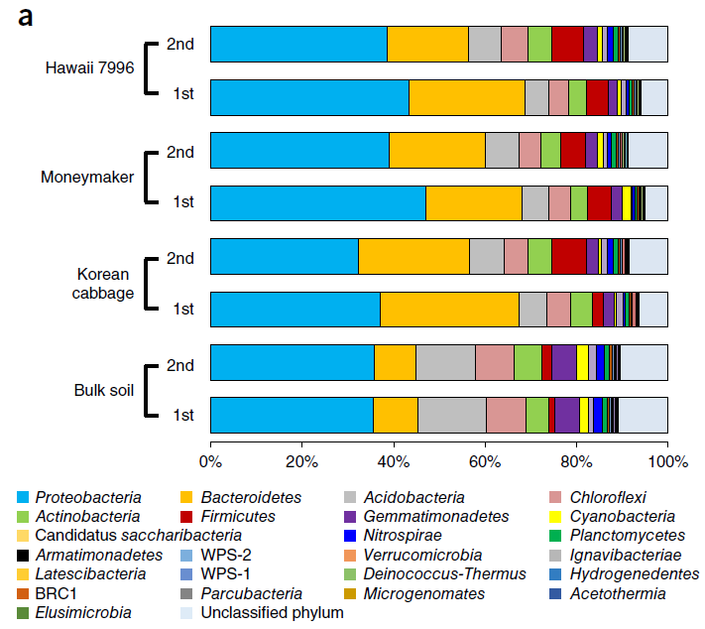
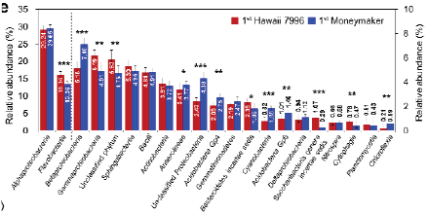
Result 1: Microbiome structures differed between Hawaii 7996 and Moneymaker in mesocosm experiment and pot experiment.
A
B
Soil
Second
First
1.First sampling: active growth and first flowering stage
2.Second sampling: fruiting and senescence stage
C
D
Hawaii 7996: Flavobacteriia, Flavobacteriaceae, Sphingomonadaceae, Pseudomonadaceae (黄杆菌，鞘脂单胞菌，假单胞菌)
Moneymaker: unclassified Alphaproteobacteria, unclassified Proteobacteria, Comamonadaceae, Oxalobacteraceae (α-，β-变形菌)
Plant rhizosphere < Bulk soil
First sampling < Second sampling
Notes:
结论1，抗病品种Hawaii7996和易感品种Moneymaker的根际微生物有差异。作者分别在塑料大棚和温室进行了番茄的种植。在塑料大棚的系统中，作者将两个番茄品种以及洋白菜随机种植，并在植株活跃生长的开花期和成熟期两个时期分别取样，对其微生物组进行了16S测序。PCOA图中可以看出，土壤中的微生物与植物根际的微生物明显不同，绿色代表的洋白菜和下方的番茄微生物也不同，这是物种之间的差异，两个番茄品种的微生物组是有差异的，但取样时间引起的差异更明显。通过计算α多样性发现，土壤中微生物的多样性高于植物根际，而植株第二次取样也就是成熟期的根际微生物组多样性高于开花期。进一步通过对两个番茄品种第一次收样时的微生物组在class（纲）和family（科）水平上进行比较后发现，7996特异性的富集了黄杆菌、鞘脂单胞菌、假单胞菌，而moneymaker特异富集了一些α-，β-变形菌。

Slide 7
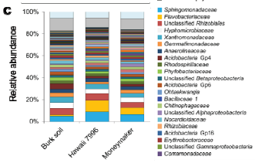
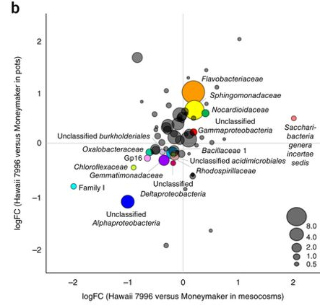
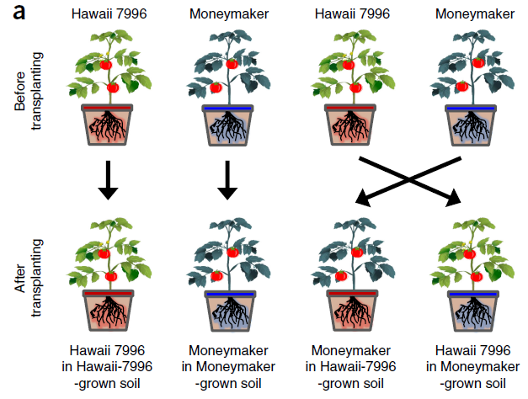
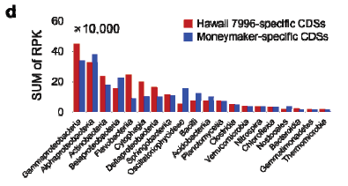
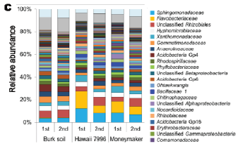
Result 1: Microbiome structures differed between Hawaii 7996 and Moneymaker in mesocosm experiment and pot experiment.
A
B
Flavobacteria
Flavobacteria
Pot experiment (Green house)
Mesocosm and pot experiments
Flavobacteria
C
D
Flavobacteria
Flavobacteria
First sampling in mesocosm experiment
First and second sampling in mesocosm experiment
Notes:
另一方面，作者进行了盆栽实验，将塑料大棚中的土壤装入盆中放在可控温控湿的温室中种植了两个番茄品种，得到了与塑料大棚实验中相似的结果。考虑到在16S测序过程中，PCR产生的偏好性，作者对第一次收取样品的微生物组进行了宏基因组测序，也与16S测序结果相吻合。通过多组实验、多种测序方法证明了抗病品种7996和易感品种moneymaker的根际微生物存在差异。并且发现，在抗病品种中特异性的富集一类细菌——黄杆菌。

Slide 8
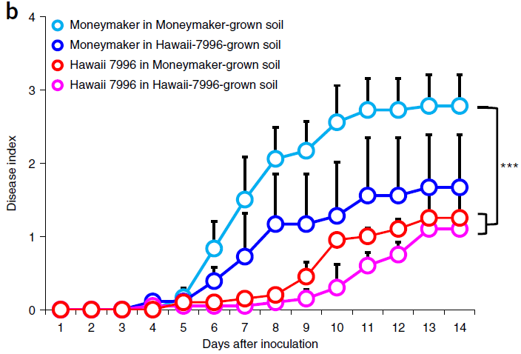
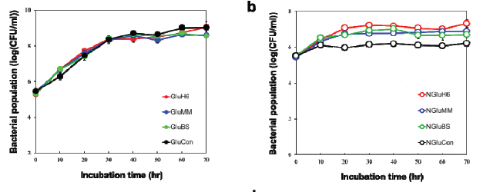
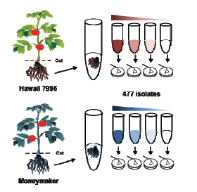
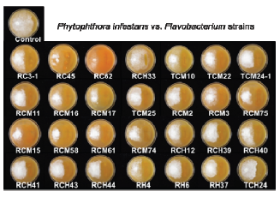
Result 2: The slope of disease progression was lower and disease severity was reduced in Moneymaker plants that grown in Hawaii 7996-grown soil.
A
B
M in M
M in H
H in M
H in H
C
D
E
root exudates
(no substantial effect)
Bacteria isolation (all: 477; flavobacteria:31)
(none were antibacterial toward Ralstonia nor suppress wilt)
Notes:
结论2，将抗性品种的根际微生物移植到非抗性品种根际能够缓解植株的疾病症状。通过盆栽移植，作者进行了两个番茄品种根际微生物互换实验，简单来说，就是将抗病品种移植到之前种过易感品种的土中，将易感品种移植到之前种过抗病品种的土中。结果发现，从发病症状来看，易感品种在易感土壤中发病症状最强，移植进抗病品种的土中会缓解症状。这些结果表明，种过抗病品种的土壤确实影响了易感品种的发病，而原因有可能是抗病品种分泌到土中具有抗病原菌作用的分泌物，也有可能是抗病品种特异性富集了一些有益微生物。为了证明第一种可能，作者首先将抗病品种的分泌物与青枯菌共培养，但是不论在培养基加糖不加糖的条件下，分泌物都没有抑制青枯菌的生长，所以作者想进一步验证是否是微生物的作用产生了抗病的功能呢？作者收取了两个品种的根系样品，通过梯度稀释、平板培养，分离到了447株细菌，并在其中得到了31株对番茄有促生或抗病作用的黄杆菌。但是，不论是只将这些黄杆菌与青枯菌共培养还是在植物中加入这些菌，都没有看到抑菌和抗病的作用。既然16S和宏基因组数据都明显地显示了黄杆菌在抗病品种根际的富集，那它的存在应该有一定的意义，可能作者做了多种尝试，比如常规的增加黄杆菌的加入量、改变培养基成分等优化体系的方法都没有达到理想的效果，或者换种思路，尝试验证其它差异菌的功能，但是这样不能从根本上解决问题，即使是相同的16S，细菌的性质也有很大差异，作者考虑到可能是细菌分离培养技术的限制，导致未分到具有抗病功能的黄杆菌，所以作者开始从基因组数据中挖掘信息。

Slide 9
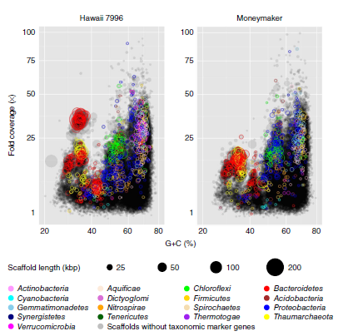
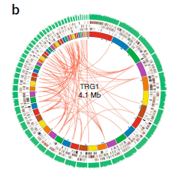
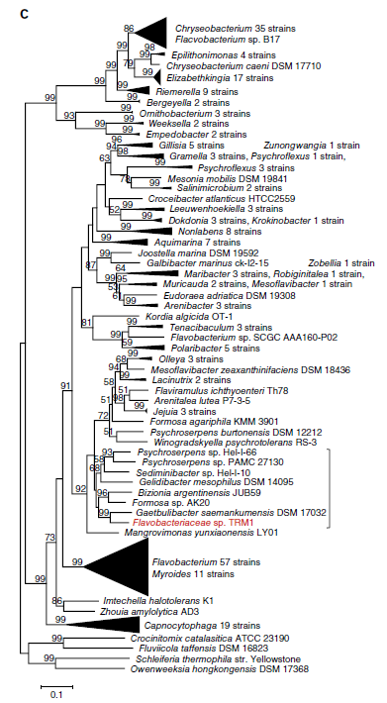
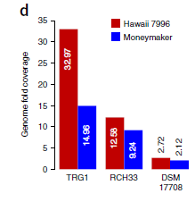
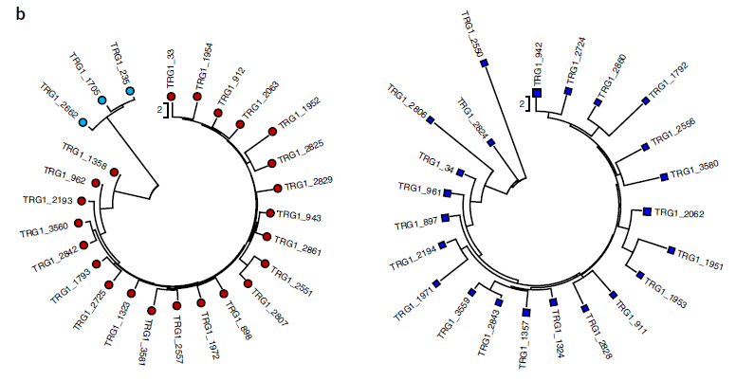
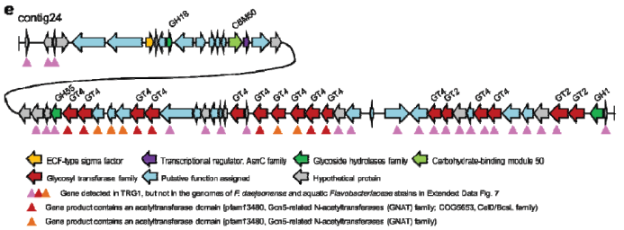
Result 3: A hypothetical flavobacterial genome from the tomato rhizosphere, TRG1, which comprised 57 contigs and was 4.11 Mb without rRNA operons was reconstructed.
A
B
C
Bacteroidetes
Gaetbulibacter saemankumensis DSM 17032
Flavobacteriaceae sp. TRM1
A hypothetical flavobacterial genome
D
E
Infer functions:
Carbohydrate utilization
Gliding motility
IX (Por) secretion system
Iron acquisition
Synthesize phytase...
Mannose transporter...
Notes:
通过宏基因组的数据比较发现，相对于易感品种，抗病品种7996富集了一类GC含量位于30-40%的DNA，主要是Bacteroidetes拟杆菌门。黄杆菌属于拟杆菌门，在这些DNA片段中，作者重构出了一个假设的黄杆菌基因组，除了16S片段外大小约4.1M，命名为TRG1，这是第一次从番茄根际宏基因组中组装微生物基因组，同时将新构建的TRG1与255个已知的黄杆菌基因组进行比对后发现，它跟一种泥滩杆菌的基因组很相似，TRG1很有可能是一种新的黄杆菌分类学分支。作者将TRG1和两种黄杆菌的基因组分别在两个品种的宏基因组数据中比较后发现，TRG1在抗病品种中的丰度远高于易感品种，表明抗病品种富集了这类菌，通过基因功能分析后发现，TRG1基因组中包含了糖类利用、铁摄取、多种酶合成以及多种糖类物质转运的功能基因，这些基因很有可能有助于这种菌促进植物生长及抗病。

Slide 10
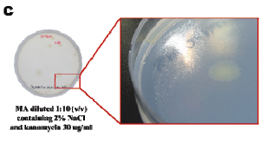
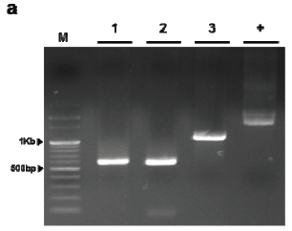
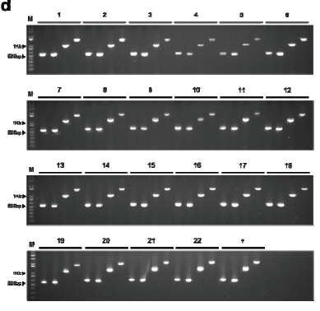
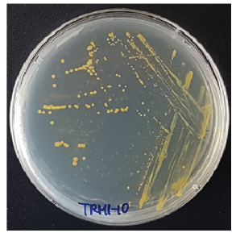
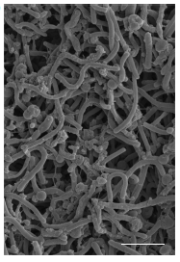
Result 4: TRM1, the presumptive uncultured microbe combining TRG1 sequence information and metadata from the mesocosm experiment was cultivated.
A
B
1:10 diluted Marine broth(2% NaCl)
D-mannose as a sole carbon source
Kanamycin-resistance
Marker
rpoA
recA
secY
16S
C
D
TRM1-10
22 candidate TRM1 colonies with TRG1 sequences
Notes:
作者试图分离拥有TRG1基因组的黄杆菌，将其命名为TRM1。首先，在之前的分离方法中未能分离到这种菌，很有可能这种菌需要特殊的培养基或者培养条件。参考TRG1基因组数据，发现TRM1和8种海洋细菌处在同一分类学分支，同时这种菌很可能只利用D-甘露糖作为碳源，以及具有抗卡那霉素的作用，所以作者利用稀释10倍的含有2%NaCl的海洋培养基，添加特殊碳源和卡那霉素，分离到了22株TRM1候选菌。通过TRG1基因组信息设计了3个片段大小不同的特异性引物，利用PCR扩增，证明了这22株菌都具有TRM1的基因组信息。并从中选择了1株菌TRM1-10进行后续实验。

Slide 11
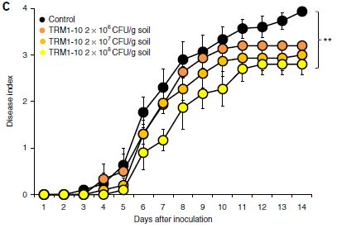
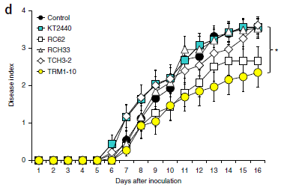
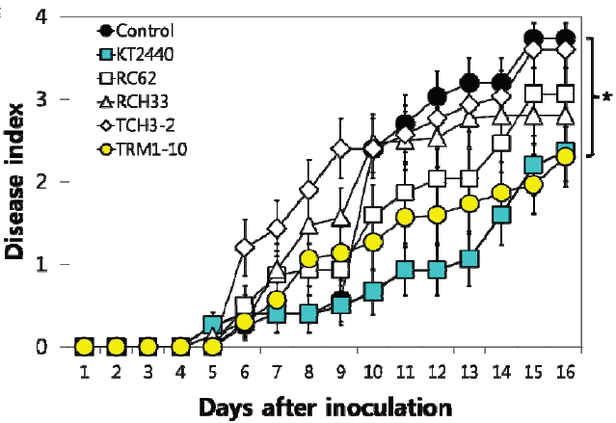
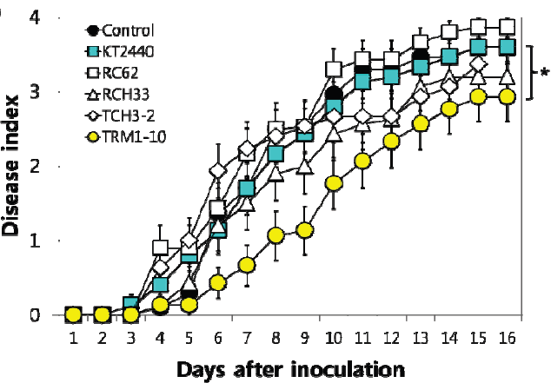
Result 5: Application of TRM1-10 at approximately 2×10⁸ CFU/g of soil significantly suppress wilt symptoms.
A
B
2×10⁶
2×10⁷
2×10⁸
TRM1-10
Sterile nursery soil
Non-sterile nursery soil
C
D
TRM1-10
KT2440
TRM1-10
Sterile commercial horticultural nursery soil
Non-sterile commercial horticultural nursery soil mixed with non-sterile natural field soil
Notes:
为了验证TRM1-10是否参与植物抗病过程，作者首先将这种菌与青枯菌进行共培养，结果发现，TRM1-10并不能对青枯菌的生长产生抑制作用，但是将这种菌添加至植物根系后，植物对青枯菌的抗病性增强，并且受浓度的影响，当添加浓度为2*10⁸时，才能明显的提高植物抗病性，至于是否再增加添加量会进一步增强抗病性，作者没有提到。另一方面，作者在不同的土壤，添加不同的菌进行对比后，都能发现TRM1-10能够缓解植株的疾病症状。由此可以得出结论，在抗病品种中富集的黄杆菌能够提高番茄抗青枯病的能力。

Slide 12
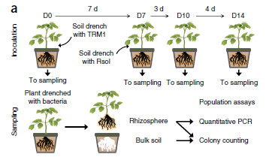






Result 6: Population dynamics of TRM1-10 and R. solanacearum in plants grown in sterile horticultural nursery soil.
A
B
qPCR vs colony counting (concordance)
qPCR detected more cells than colony counting
C
D
Hawaii 7996 (TRM1)
Moneymaker (TRM1)
Moneymaker (TRM1+Rsol)
Bulk soil (TRM1/Rsol)
Moneymaker (TRM1+Rsol)
Moneymaker (Rsol)
Notes:
为了深入挖掘TRM1-10缓解植物发病的机制，作者分析了实验体系中随着时间增加，TRM1-10和青枯菌的丰度变化。同样是盆栽体系，作者分别收取了0天、7d、10d和14d的根系微生物组样品，在植物生长至7d时接种了青枯菌。采用了2种计数方式，qpcr和涂板计数，虽然qpcr得到的数量比涂板数量多，但两种方式得到的趋势基本一致。首先，在只接种TRM1-10的体系中，抗病品种7996在根际富集的TRM1的数量明显高于易感品种moneymaker，这与16S测序数据相一致，但通过对土壤中TRM1的数量进行分析后发现，在抗病品种的土中，TRM1-10的数量变化不大，但易感品种的土中丰度下降明显，推测很有可能抗病品种更易招募这类菌在其根际定殖。另一方面，对于易感品种来说，接种病原菌后TRM1-10的数量也有一定的提高，但是，不论是否添加TRM1-10，病原菌在易感品种的根际数量没有太大的变化。这部分数据虽然能够看出在整个过程中，TRM1和青枯菌的丰度会受到一定的影响，但并不能得到类似TRM1丰度升高导致病原菌丰度下降从而缓解植物疾病症状的结论，所以还需要更多的数据去发掘TRM1帮助植物抗病的机制。

Slide 13
Conclusion
第一步：寻找差异菌
Result 1: Microbiome structures differed between Hawaii 7996 and Moneymaker in mesocosm experiment and pot experiment.
第二步：培养差异菌
Result 2: The slope of disease progression was lower and disease severity was reduced in Moneymaker plants that grown in Hawaii 7996-grown soil.
Result 3: A hypothetical flavobacterial genome from the tomato rhizosphere, TRG1, which comprised 57 contigs and was 4.11 Mb without rRNA operons was reconstructed.
Result 4: TRM1, the presumptive uncultured microbe combining TRG1 sequence information and metadata from the mesocosm experiment was cultivated.
第三步：验证差异菌功能
Result 5: Application of TRM1-10 at approximately 2×10⁸ CFU/g of soil significantly suppress wilt symptoms.
Result 6: Population dynamics of TRM1-10 and R. solanacearum in plants grown in sterile horticultural nursery soil.

Slide 14

Discussion
1.We only carried out one mesocosm experiment and one pot experiment with five technical replications. （重复性，replication）
2.Soils are heterogeneous and it is not clear whether similar bacterial species would be present in different soils. （普遍性， generalizable ）
3. The biochemical or molecular bases for rhizosphere assemblage of microbiota in these cultivars has not been studied.（宿主调控基因，one or more quantitative trait loci）
4. The uptake of monosaccharides by TRM1 reduces the availability of sugars to which R. solanacearum lectin binds and thereby reduces infection.（抗病机理， bacteria metabolism and functions ）
5. It is possible that TRM1 comprises a collection of closely related strains, such as TRM1-1–TRM1-22. （益生菌，more bacteria）
6. The rhizosphere microbiota may have a probiotic effect on plant functions. （根际的重要性）

